Slide 1
Logic Gates
Dr.Ahmed Bayoumi
Dr.Shady Elmashad

Slide 2
Objectives
Identify the basic gates and describe the behavior of each
Combine basic gates into circuits
Describe the behavior of a gate using Boolean expressions, truth tables, and logic diagrams

Slide 3
Definition
A gate is a device that performs a basic operation on electrical signals
Gates are combined into circuits to perform more complicated tasks
describing the behavior of gates and circuits by
Boolean expressions
logic diagrams
truth tables

Slide 4
Gates
six types of gates
NOT
AND
OR
XOR
NAND
NOR

Slide 5
NOT Gate
A NOT gate accepts one input value and produces one output value
By definition, if the input value for a NOT gate is 0, the output value is 1, and if the input value is 1, the output is 0
A NOT gate is sometimes referred to as an inverter because it inverts the input value

Slide 6
AND Gate
An AND gate accepts two input signals
If the two input values for an AND gate are both 1, the output is 1; otherwise, the output is 0

Slide 7
OR Gate
If the two input values are both 0, the output value is 0; otherwise, the output is 1

Slide 8
XOR Gate
XOR, or exclusive OR, gate
An XOR gate produces 0 if its two inputs are the same, and a 1 otherwise
Note the difference between the XOR gate and the OR gate; they differ only in one input situation
When both input signals are 1, the OR gate produces a 1 and the XOR produces a 0

Slide 9
NAND and NOR Gates
The NAND and NOR gates are essentially the opposite of the AND and OR gates, respectively

Slide 10
Review of Gate Processing
A NOT gate inverts its single input value
An AND gate produces 1 if both input values are 1
An OR gate produces 1 if one or the other or both input values are 1
An XOR gate produces 1 if one or the other (but not both) input values are 1
A NAND gate produces the opposite results of an AND gate
A NOR gate produces the opposite results of an OR gate

Slide 11
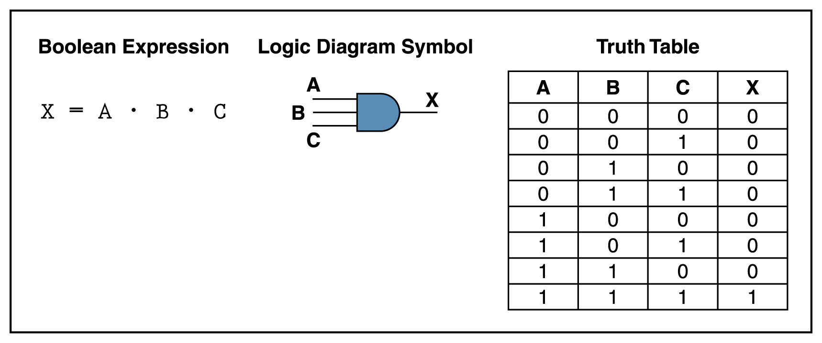
Gates with More Inputs
Gates can be designed to accept three or more input values
A three-input AND gate, for example, produces an output of 1 only if all input values are 1

Slide 12
Circuits
Two general categories
In a combinational circuit, the input values explicitly determine the output
In a sequential circuit, the output is a function of the input values as well as the existing state of the circuit
As with gates, we can describe the operations of entire circuits using three notations
Boolean expressions
logic diagrams
truth tables

Slide 13
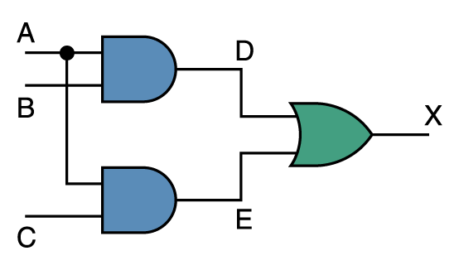
Combinational Circuits
Gates are combined into circuits by using the output of one gate as the input for another

Slide 14
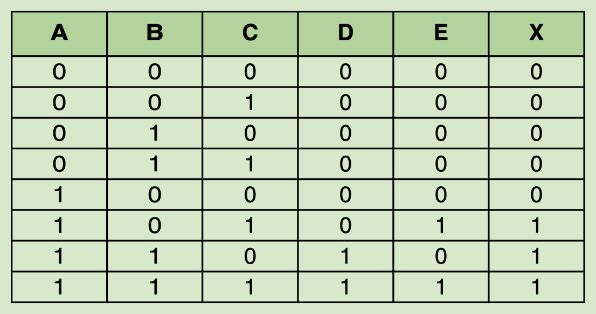
Combinational Circuits
Because there are three inputs to this circuit, eight rows are required to describe all possible input combinations
This same circuit using Boolean algebra:
(AB + AC)

Slide 15
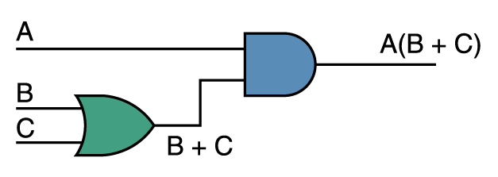
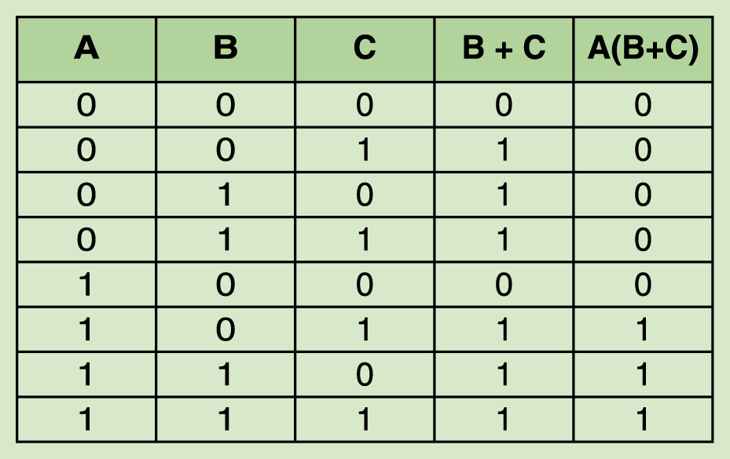
Now let’s go the other way; let’s take a Boolean expression and draw
Consider the following Boolean expression: A(B + C)
Now compare the final result column in this truth table to the truth table for the previous example
They are identical

Slide 16
Properties of Boolean Algebra

Slide 17
Adders
At the digital logic level, addition is performed in binary
Addition operations are carried out by special circuits called, appropriately, adders
The result of adding two binary digits could produce a carry value
Recall that 1 + 1 = 10 in base two
A circuit that computes the sum of two bits and produces the correct carry bit is called a half adder

Slide 18
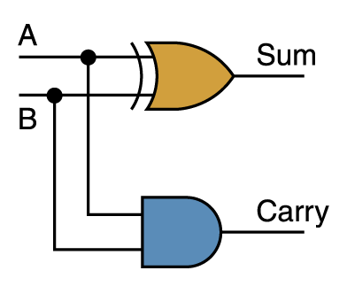
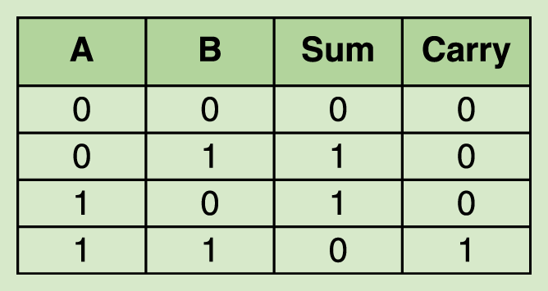
Adders
Circuit diagram representing a half adder
Two Boolean expressions:
sum = A ⊕ B
carry = AB

Slide 19
Integrated Circuits
Integrated circuits (IC) are classified by the number of gates contained in them

Slide 20
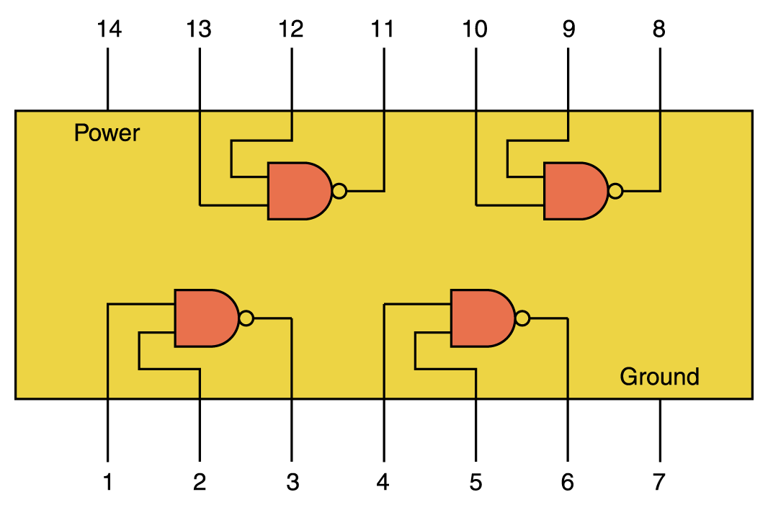
Integrated Circuits

Slide 21
CPU Chips
The most important integrated circuit in any computer is the Central Processing Unit, or CPU
Each CPU chip has a large number of pins through which essentially all communication in a computer system occurs

Slide 22
The Von Neumann Model
Basic components
Instruction processing

Slide 23
The von Neumann Model - 1
Memory
MAR
MDR
Processing Unit
Input
ALU
Register Set
Output
*keyboard
*monitor
Control Unit
PC
IR
Memory: holds the instructions and data
Processing Unit: processes the information
Input: external information into the memory
Output: produces results for the user
Control Unit: manages computer activity

Slide 24
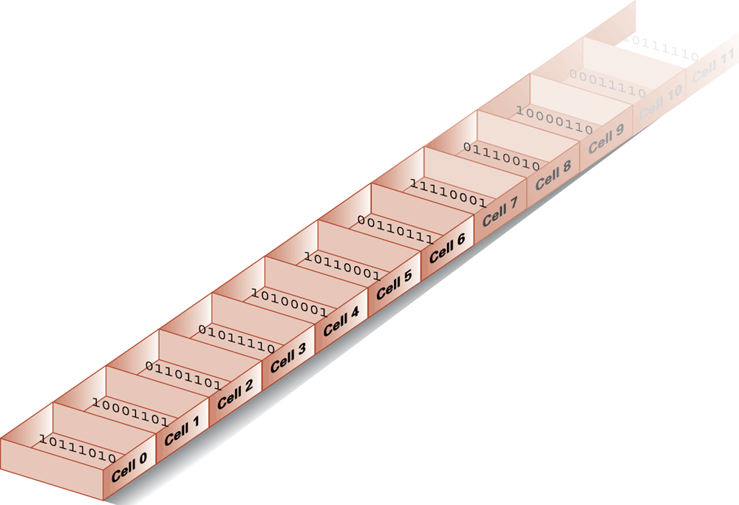
The von Neumann Model - 2
Memory (RAM)
Each location has an address and contents
Address: set of bits that uniquely identify a memory location
(eg. 20 bits gives an address space of 2²⁰ locations)
Addressability (Byte vs. Word):
The size of the memory location referenced by a given address

Slide 25
Measuring Memory Capacity
Kilobyte: 2¹⁰ bytes = 1024 bytes
Example: 3 KB = 3 times1024 bytes
Megabyte: 2²⁰ bytes = 1,048,576 bytes
Example: 3 MB = 3 times 1,048,576 bytes
Gigabyte: 2³⁰ bytes = 1,073,741,824 bytes
Example: 3 GB = 3 times 1,073,741,824 bytes

Slide 26
Data Communication Rates
Measurement units
Bps: Bits per second
Kbps: Kilo-bps (1,000 bps)
Mbps: Mega-bps (1,000,000 bps)
Gbps: Giga-bps (1,000,000,000 bps)
Bandwidth: Maximum available rate

Slide 27
The von Neumann Model - 3
Processing Unit
ALU (Arithmetic and Logic Unit)
Generally operates on entire words of data
Some also work on subsets of words (eg. bits and bytes)
Registers:
Small, fast “on-board” storage for words
Close to the ALU (much faster access than RAM)
Control Unit
Program Counter (PC) or Instruction Pointer
Holds the address of the next instruction to be executed
Instruction Register (IR)
Holds the instruction being executed
The control unit coordinates all actions needed to execute the instruction

Slide 28
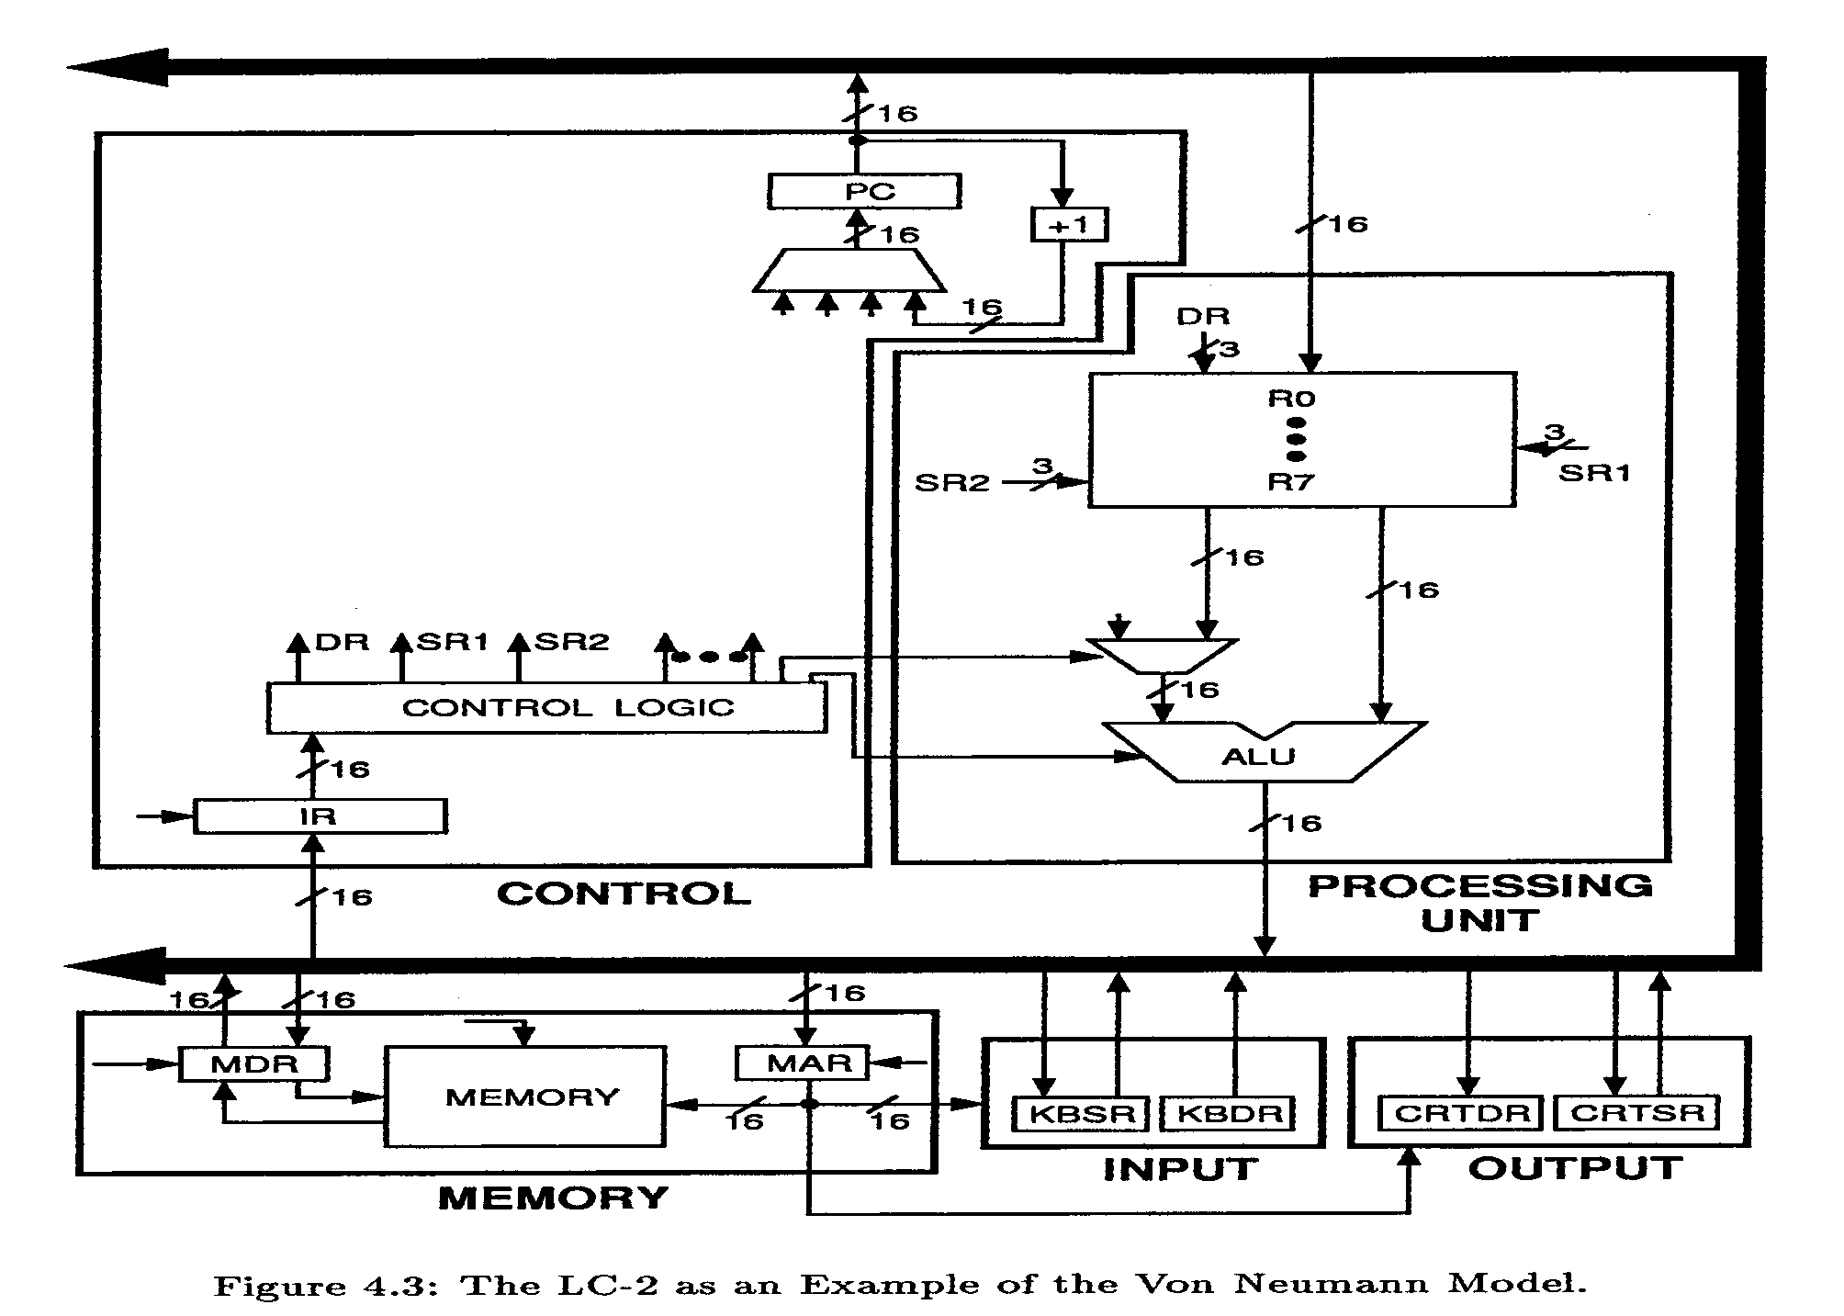

Slide 29
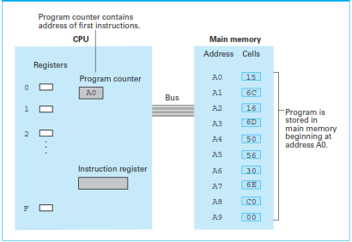

Slide 30
Arithmetic/Logic Operations
Logic: AND, OR, XOR
Rotate and Shift: circular shift, logical shift, arithmetic shift
Arithmetic: add, subtract, multiply, divide

Slide 31
Instructions
Instruction word: 16 bits
Opcode
defines (names) the instruction to be executed
bits[15:12]: 4 bits allow 16 instructions
Operands
Registers: 8 registers (i.e. require 3 bits for addressing)
Address parameters: Offset (9 bits) or Index (6 bits) (more later)
Immediate value: 5 bits
Examples
ADD DR, SR1, SR2 ; DR ← (SR1) + (SR2)
[15:12] [11:9] [8:6] [2:0] - Note: (Reg1) means “content of Reg1”
LDR DR, BaseR, Offset ; DR ← Mem[BaseR + Offset]
[15:12] [11:9] [8:6] [5:0] - Note: Mem[loc] means “content of memory location loc”

Slide 32
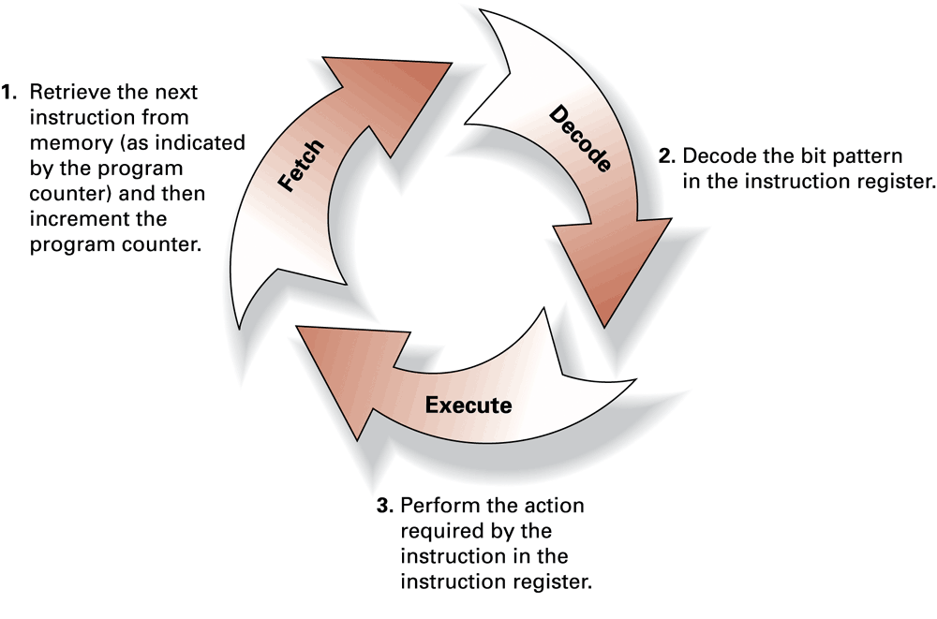
Instruction Cycle - 1
Six phases (steps)
Fetch: load IR with instruction from memory
Decode: determine action to take (which instructions)
Evaluate address: compute memory address of operands, if any
Fetch operands: read operands from memory or registers
Execute: perform instruction
Store results: write result to destination (register or memory)

Slide 33
Instruction Cycle - 2
Fetch
This actually takes several steps, represented here as “micro-instructions”, each of which can take a number of machine cycles to implement:
MAR ← (PC) ; use the value in PC to access memory
MDR ← Mem[MAR] ; read memory location to MDR
IR ← (MDR) ; move (MDR) to IR
PC← (PC) + 1 ; increment the value of PC
Decode
A decoder reads the opcode bit pattern & sets up the next state of the machine to appropriately use the remaining bits of the instruction.

Slide 34
Instruction Cycle - 3
Evaluate Address
Computes the address of the memory location required to process the instruction (if any): e.g. the location from which to obtain a value.
This is known as the Effective Address (EA).
Fetch Operands
Obtains the source operand(s) (if any) either from Registers or from memory, i.e. from the EA calculated in the previous step.

Slide 35
Instruction Cycle - 4
Execute
Carries out the execution of the instruction - e.g. add two operands present at the input of the ALU
Store Result
Writes the result (if any) to its designated destination, either register or memory (using the EA calculated earlier)
Start over …
Recall that the PC was incremented already in the first step, so the next Fetch will bring back the next instruction - unless the instruction just executed changed the PC.

Slide 36
Instruction Cycle - 5
Some instructions don't need all 6 phases
If only using registers, skip Evaluate Address
If only moving data, skip Execute
Control Instructions
These change the sequence of instructions
Branch
Loop
Function or procedure call
Execute phase changes the content of the PC, so the next instruction will be out of sequence.

